Slide 1


Communication solutions
Solar for everybody

Slide 2
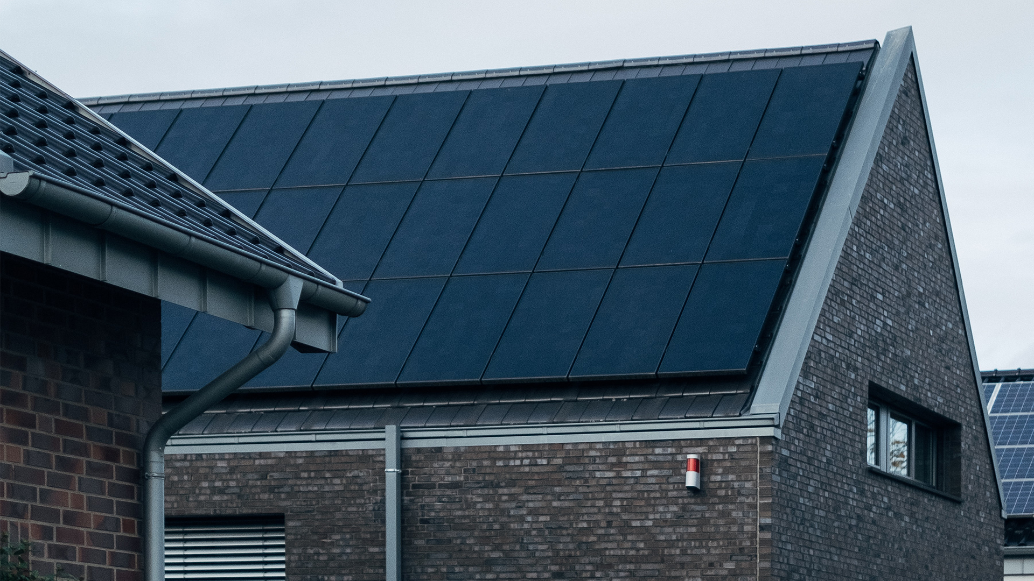
One-inverter solutions
Smart management
with Solplanet App

Slide 3
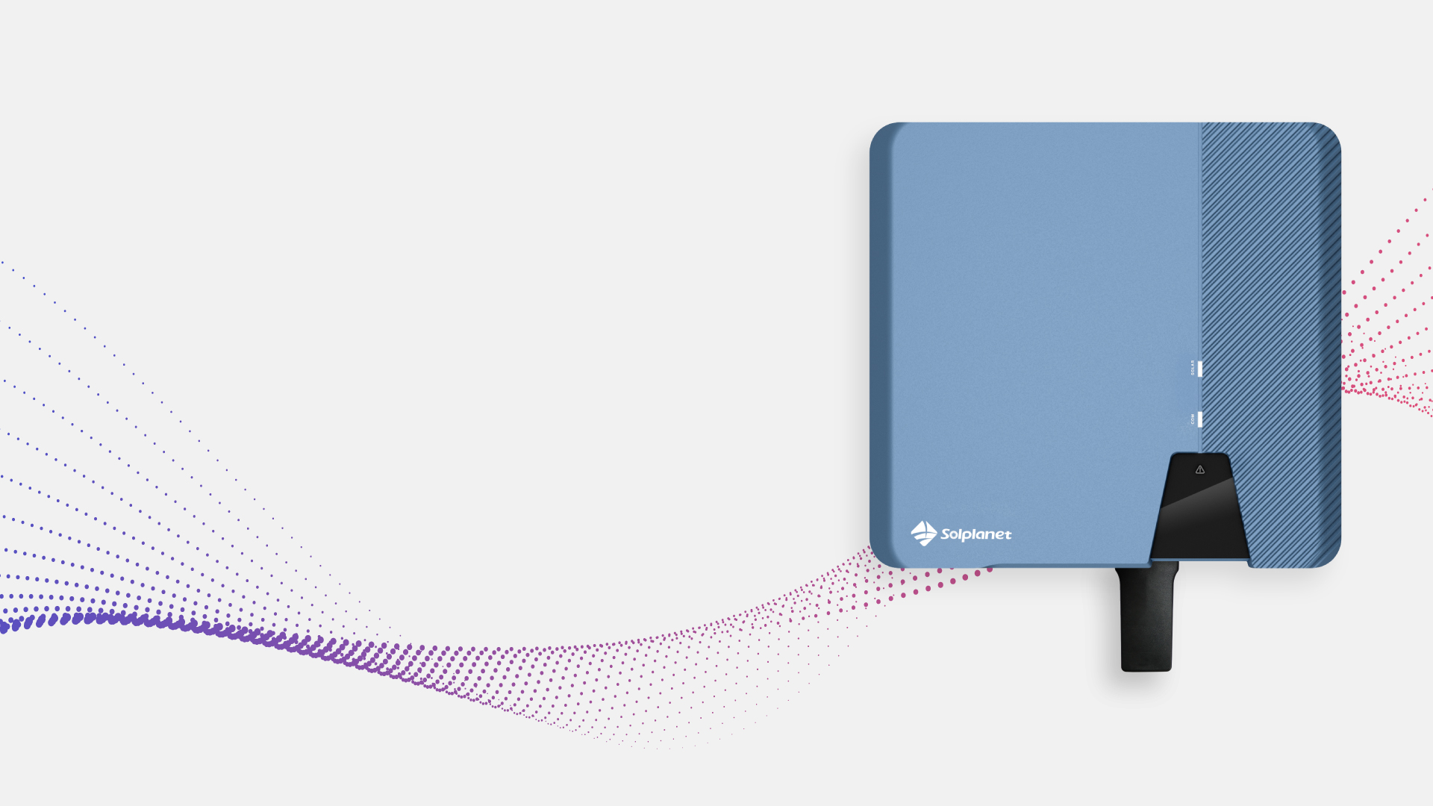

One-inverter solutions with
Wi-Fi Stick
Smart management
with Solplanet App

Slide 4
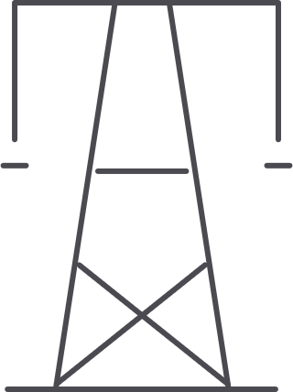
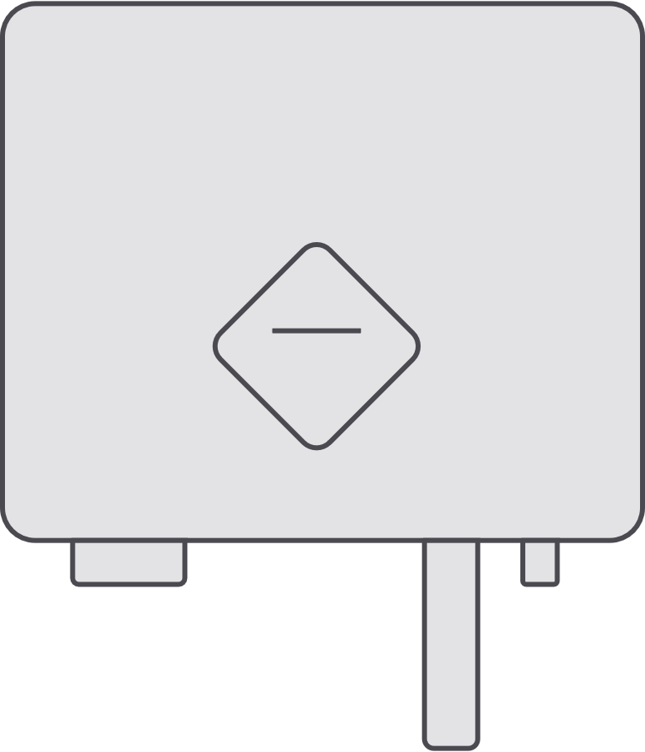
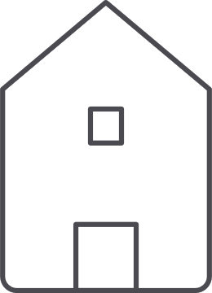
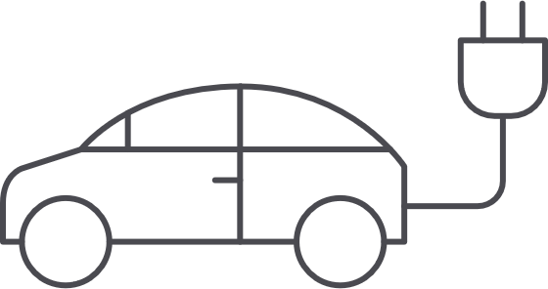




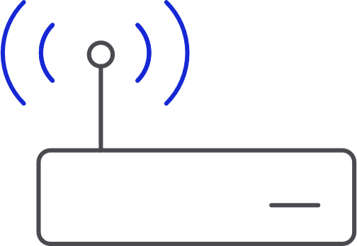



One inverter with Wi-Fi stick for
Monitoring
Grid
Home
EV
Web
Application
Router
Internet
AiSWEI Cloud
Single Phase
Three Phase
Monitoring
Diagram
App
· ASW 1000-3000 S-S
· ASW 3000-5000 S
· ASW 6000-10000 S
· ASW 3000-10000 T
· ASW 8-20K LT-G2
· ASW 8-20K LT-G2 Pro
· ASW 25-40K LT-G2
· ASW 30-50K LT-G2
· Production
Data
Energy
RS485

Slide 5
One inverter with Wi-Fi stick for
Monitoring
Grid
Home
EV
Web
Application
Router
Internet
AiSWEI Cloud
Single Phase
Three Phase
Monitoring
Diagram
App
· ASW 1000-3000 S-S
· ASW 3000-5000 S
· ASW 6000-10000 S
· ASW 3000-10000 T
· ASW 8-20K LT-G2
· ASW 8-20K LT-G2 Pro
· ASW 25-40K LT-G2
· ASW 30-50K LT-G2
· Production
Data
Energy
RS485

Slide 6
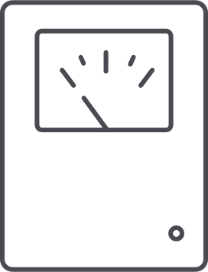

One inverter with Wi-Fi stick for
Monitoring
and 0-export
Smart Meter
Grid
Home
EV
Web
Application
Router
Internet
AiSWEI Cloud
Single Phase
Three Phase
Monitoring
Diagram
App
· ASW 1000-3000 S-S
· ASW 3000-5000 S
· ASW 6000-10000 S
· ASW 3000-10000 T
· ASW 8-20K LT-G2
· ASW 8-20K LT-G2 Pro
· ASW 25-40K LT-G2
· ASW 30-50K LT-G2
· Production
· Consumption
· Self-consumption
Data
Energy
RS485

Slide 7
One inverter with Wi-Fi stick for
Monitoring
and 0-export
Smart Meter
Grid
Home
EV
Web
Application
Router
Internet
AiSWEI Cloud
Single Phase
Three Phase
Monitoring
Diagram
App
· ASW 1000-3000 S-S
· ASW 3000-5000 S
· ASW 6000-10000 S
· ASW 3000-10000 T
· ASW 8-20K LT-G2
· ASW 8-20K LT-G2 Pro
· ASW 25-40K LT-G2
· ASW 30-50K LT-G2
· Production
· Consumption
· Self-consumption
Data
Energy
RS485

Slide 8
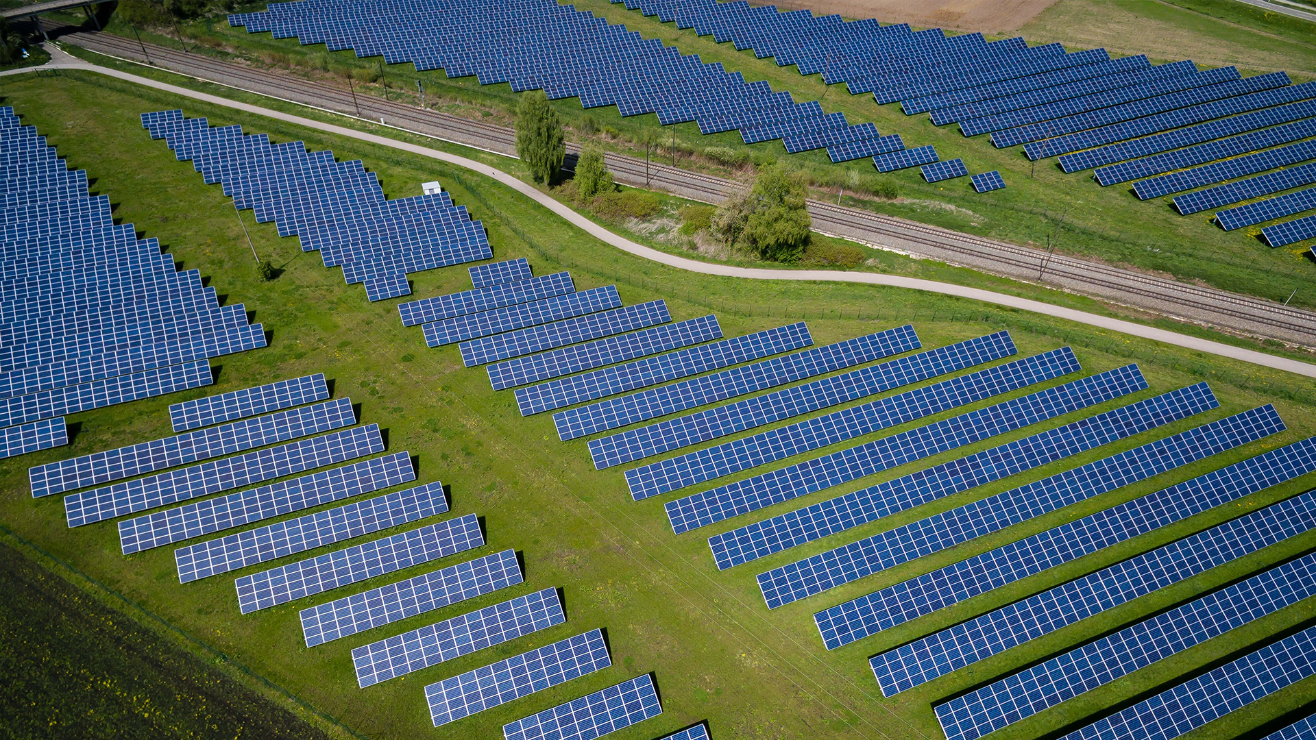
Multiple-inverter solutions
Smart management
with Solplanet App

Slide 9

Multiple-inverter solutions with
Wi-Fi Stick
Smart management
with Solplanet App

Slide 10


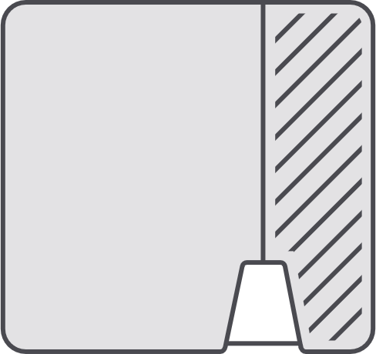
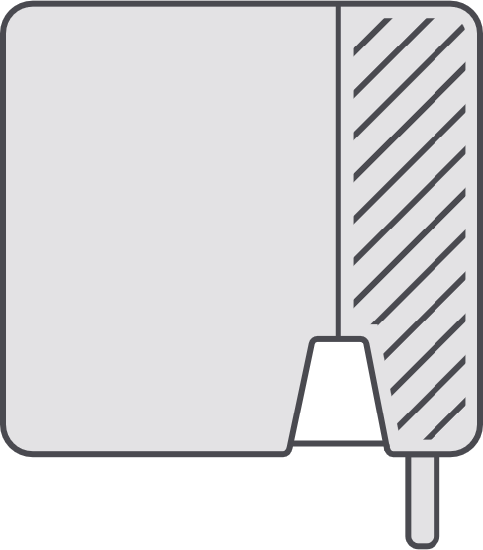




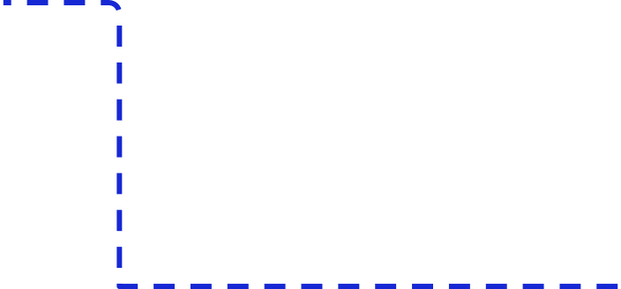
Multiple inverters with Wi-Fi stick for
Monitoring
Grid
One Wi-Fi stick
can support up to five inverters
Home
EV
UP TO
5
…
Web
Application
Router
Internet
AiSWEI Cloud
Single Phase
Three Phase
Monitoring
Diagram
App
· ASW 1000-3000 S-S
· ASW 3000-5000 S
· ASW 6000-10000 S
· ASW 3000-10000 T
· ASW 8-20K LT-G2
· ASW 8-20K LT-G2 Pro
· ASW 25-40K LT-G3
· ASW 30-50K LT-G2
· Production
Data
Energy
RS485

Slide 11
Multiple inverters with Wi-Fi stick for
Monitoring
Grid
One Wi-Fi stick
can support up to five inverters
Home
EV
UP TO
5
…
Web
Application
Router
Internet
AiSWEI Cloud
Single Phase
Three Phase
Monitoring
Diagram
App
· ASW 1000-3000 S-S
· ASW 3000-5000 S
· ASW 6000-10000 S
· ASW 3000-10000 T
· ASW 8-20K LT-G2
· ASW 8-20K LT-G2 Pro
· ASW 25-40K LT-G3
· ASW 30-50K LT-G2
· Production
Data
Energy
RS485

Slide 12

Multiple inverters with Wi-Fi stick for
Monitoring
and 0-export
Smart Meter
Grid
One Wi-Fi stick + one smart meter
can support up to four inverters
Home
EV
UP TO
4
…
Web
Application
Router
Internet
AiSWEI Cloud
Single Phase
Three Phase
Monitoring
Diagram
App
· ASW 1000-3000 S-S
· ASW 3000-5000 S
· ASW 6000-10000 S
· ASW 3000-10000 T
· ASW 8-20K LT-G2
· ASW 8-20K LT-G2 Pro
· ASW 25-40K LT-G3
· ASW 30-50K LT-G2
· Production
· Consumption
· Self-consumption
Data
Energy
RS485

Slide 13
Multiple inverters with Wi-Fi stick for
Monitoring
and 0-export
Smart Meter
Grid
One Wi-Fi stick + one smart meter
can support up to four inverters
Home
EV
UP TO
4
…
Web
Application
Router
Internet
AiSWEI Cloud
Single Phase
Three Phase
Monitoring
Diagram
App
· ASW 1000-3000 S-S
· ASW 3000-5000 S
· ASW 6000-10000 S
· ASW 3000-10000 T
· ASW 8-20K LT-G2
· ASW 8-20K LT-G2 Pro
· ASW 25-40K LT-G3
· ASW 30-50K LT-G2
· Production
· Consumption
· Self-consumption
Data
Energy
RS485

Slide 14
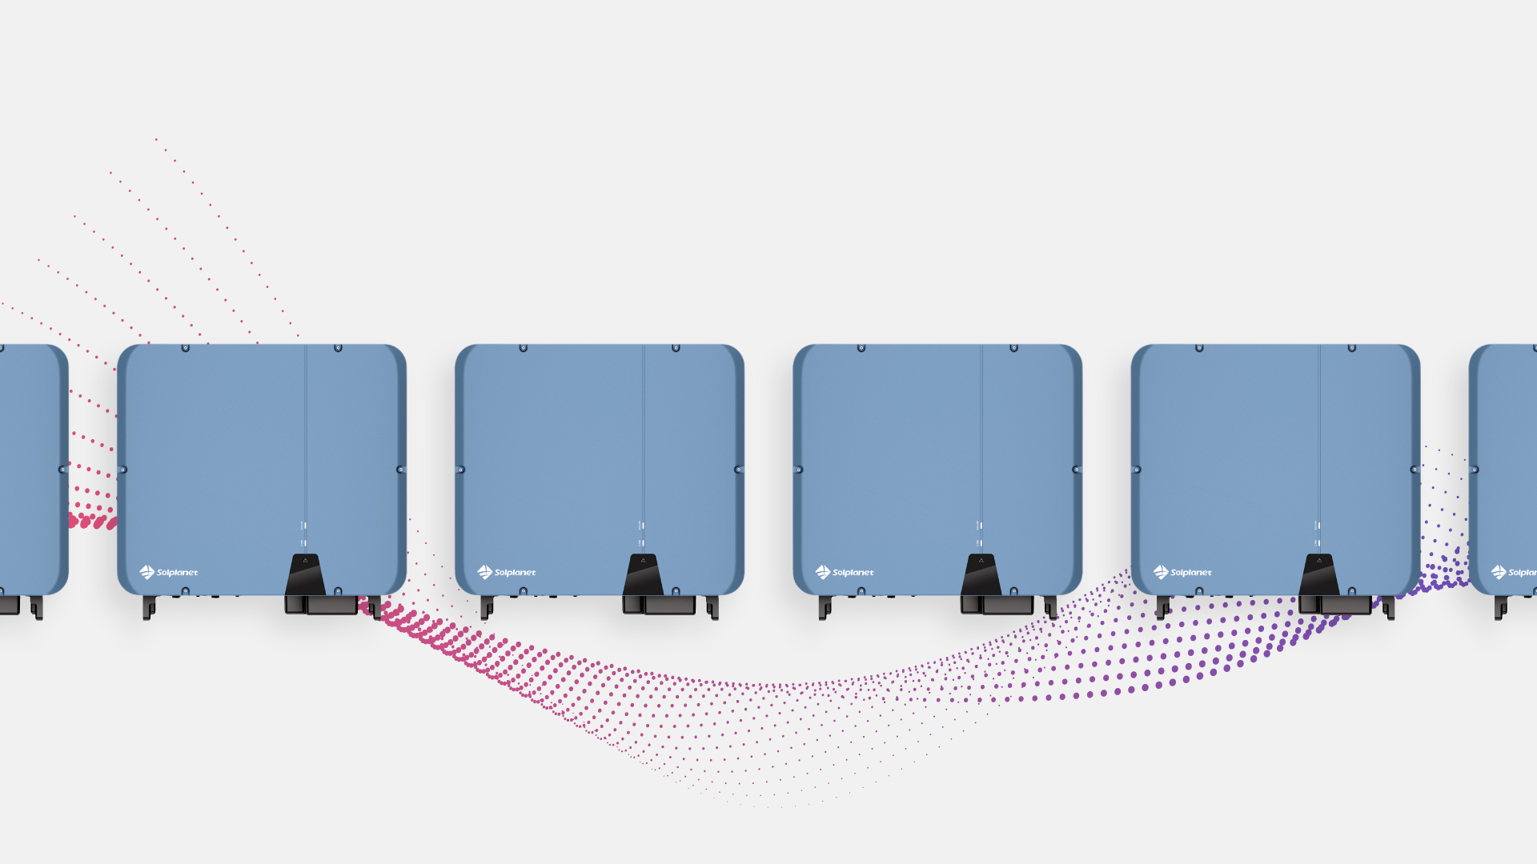
Multiple-inverter solutions with
Ailogger
Smart management
with Solplanet App

Slide 15
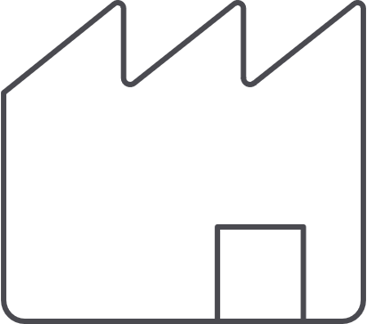



Multiple inverters with Ailogger for
Monitoring
Grid
One Ailogger
can support up to 80 inverters
Factory
EV
UP TO
80
…
Web
Application
Ailogger
Router
Internet
AiSWEI Cloud
Single Phase
Three Phase
Monitoring
Diagram
App
· ASW 1000-3000 S-S
· ASW 3000-5000 S
· ASW 6000-10000 S
· ASW 3000-10000 T
· ASW 8-20K LT-G2
· ASW 8-20K LT-G2 Pro
· ASW 25-40K LT-G3
· ASW 30-50K LT-G2
· Production
Data
Energy
RS485

Slide 16
Multiple inverters with Ailogger for
Monitoring
Grid
One Ailogger
can support up to 80 inverters
Factory
EV
UP TO
80
…
Web
Application
Ailogger
Router
Internet
AiSWEI Cloud
Single Phase
Three Phase
Monitoring
Diagram
App
· ASW 1000-3000 S-S
· ASW 3000-5000 S
· ASW 6000-10000 S
· ASW 3000-10000 T
· ASW 8-20K LT-G2
· ASW 8-20K LT-G2 Pro
· ASW 25-40K LT-G3
· ASW 30-50K LT-G2
· Production
Data
Energy
RS485

Slide 17


Multiple inverters with Ailogger for
Monitoring
and 0-export
Factory
EV
One Ailogger + one smart meter
can support up to 60 inverters
Smart Meter
Grid
UP TO
60
…
Web
Application
Ailogger
Router
Internet
AiSWEI Cloud
Single Phase
Three Phase
Monitoring
Diagram
App
· ASW 1000-3000 S-S
· ASW 3000-5000 S
· ASW 6000-10000 S
· ASW 3000-10000 T
· ASW 8-20K LT-G2
· ASW 8-20K LT-G2 Pro
· ASW 25-40K LT-G3
· ASW 30-50K LT-G2
· Production
· Consumption
· Self-consumption
Data
Energy
RS485

Slide 18
Multiple inverters with Ailogger for
Monitoring
and 0-export
Factory
EV
One Ailogger + one smart meter
can support up to 60 inverters
Smart Meter
Grid
UP TO
60
…
Web
Application
Ailogger
Router
Internet
AiSWEI Cloud
Single Phase
Three Phase
Monitoring
Diagram
App
· ASW 1000-3000 S-S
· ASW 3000-5000 S
· ASW 6000-10000 S
· ASW 3000-10000 T
· ASW 8-20K LT-G2
· ASW 8-20K LT-G2 Pro
· ASW 25-40K LT-G3
· ASW 30-50K LT-G2
· Production
· Consumption
· Self-consumption
Data
Energy
RS485

Slide 19
Firmware version
Solplanet inverters with App

Slide 20
Type | Model | Power Class | Inverter Firmware | 0-export (Multiple Inverters) | 0-export (Single Inverter) | Shadow Management
Single Phase | ASW S | 3-5 kW | 610-01049-08
 | ASW S-S | 1-3 kW | 610-01051-04
Three Phase | ASW T | 3-6 kW | 610-03034-02
 | ASW T | 8-10 kW | 610-03035-01
 | ASW LT | 15-20 kW | 610-03033-04
 | ASW LT-G2 | 8-15 kW | 610-03039-08
 | ASW LT-G2 | 17-20 kW | 610-03036-08
 | ASW LT-G2-Pro | 3-20 kW | 610-03043-00
 | ASW LT-G2 | 30-50 kW | 610-03038-03
 | ASW LT-G2-Pro | 40-50 kW | 610-03043-00
 | ASW LT-G3 | 25-30 kW | 610-03042-00
 | ASW LT-G3 | 33-40 kW | 610-03041-00
Hybrid | ASW-H-S2 | 3-6 kW | 610-02003-02

Slide 21
WiFi Stick
Connector Type | WiFi Stick Model No. | FW Version¹ | App Version¹ | 0-export² (Single Inverter) | 0-export² (Multiple Inverters) | True Zero Export³
4 pin | B30000-00-10P | 610-50039-07 | 19B01-0023R
4 pin | B31000-00-10P | 610-50042-06 | 20A12-010R
USB | B32000-00-10P | 610-50042-06 | 20A12-010R
USB | B33000-00-10P | 610-50039-07 | 19B01-0023R
FW and App version numbers are equivalent, FW versión is used by Solplanet, App versión is the number shown on the Solplanet App
Export control based on the net calculation of the phases
Export control based on the lowest consuming phase to avoid feed-in all phases, applicable only for three phase inverters

Slide 22
[Enter business address and contact details]
Solar
for everybody

Slide 23


